Slide 1
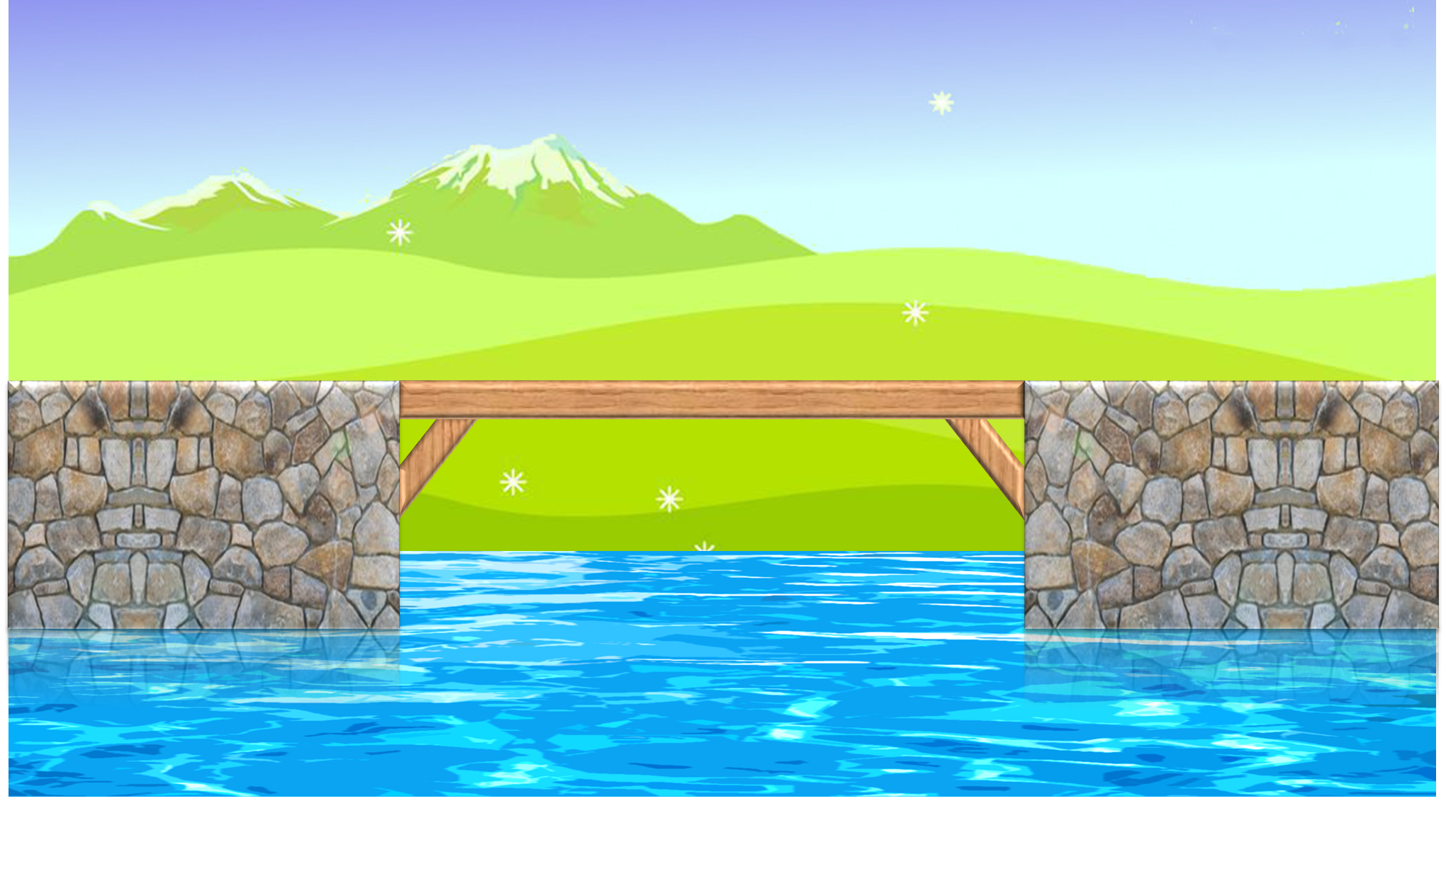
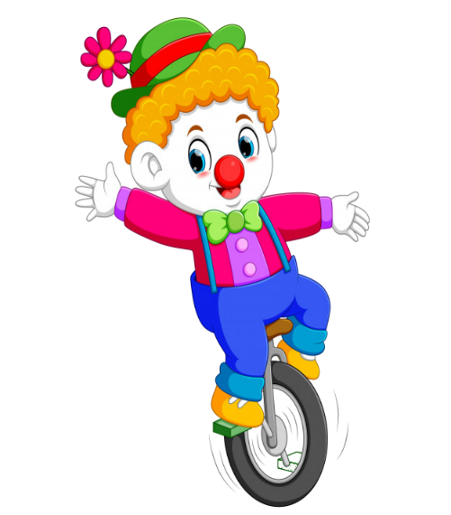
PLAY

Slide 2
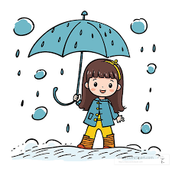
What was the weather like yesterday?
It was rainy
It’s rainy.
It was sunny
It was cloudy

Slide 3
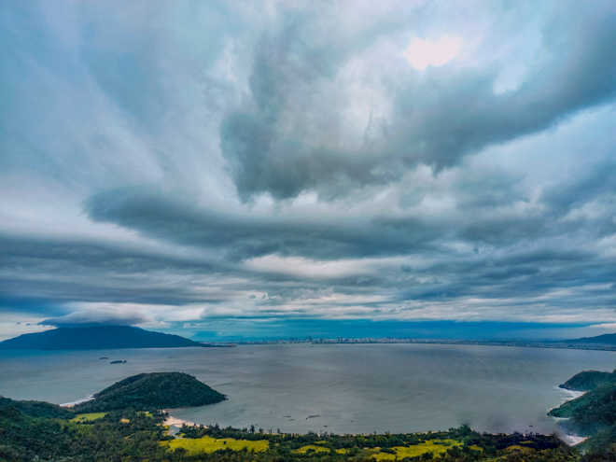
What was the weather like in Da Nang?
It was sunny
It was windy
It was rainy
It was cloudy

Slide 4
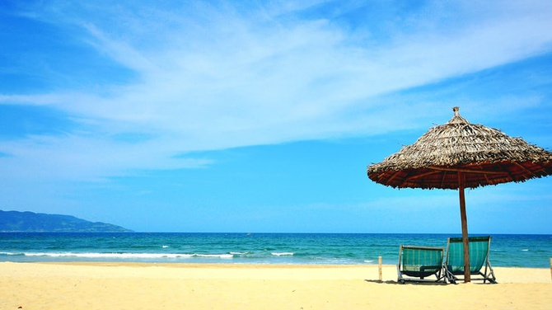
What was weather like?
What was the weather like last Sunday?
What the weather like last Sunday ?
It was sunny

Slide 5
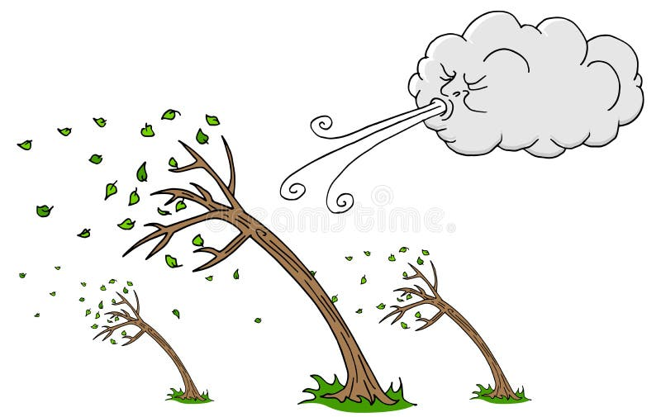
What was the weather like last night?
It was windy.
It was rainy
It was cloudy
It was sunny

Slide 6
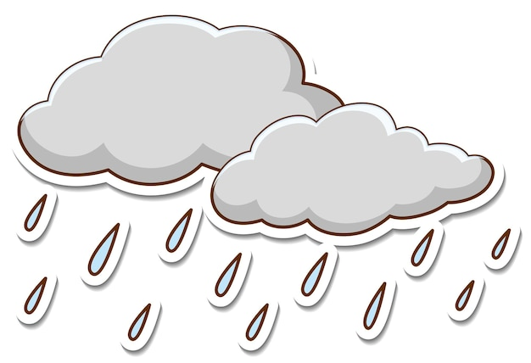
What was___like last Saturday?
weather.
rainy
It was rainy
the weather

Slide 7
What was the___like last night?
It___windy
weather/ is
the weather/was
weather/ was
the weather/ is

Slide 8
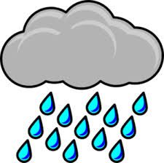
What was the weather like last Monday?
It was cloudy

Slide 9
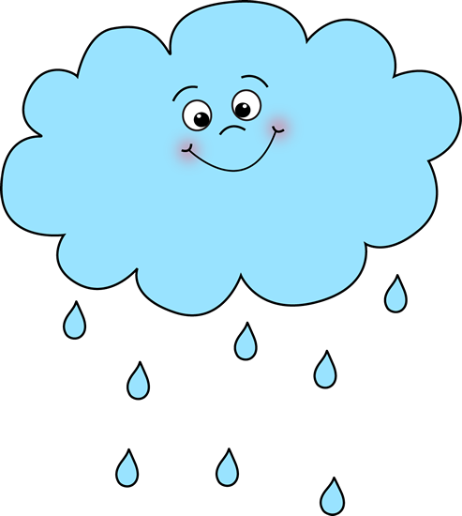
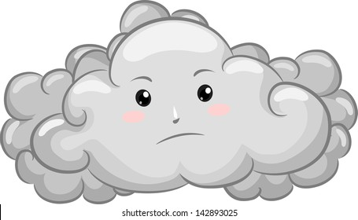
It was sunny last weekend.

Slide 10
End

