Slide 1
Fun corner and wrap-up
Notes:
Quiz game
- Pupils use their mini boards to write A on one side and B on the other side.
- Teacher asks pupils to look at the question and choose the correct answer in only 10 seconds. Then hold up their board.

Slide 2
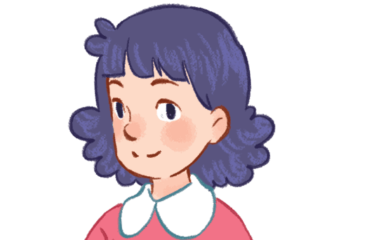
What’s your name?
A
B
My name’s
Hoa.
Hi, Ms Hoa!

Slide 3
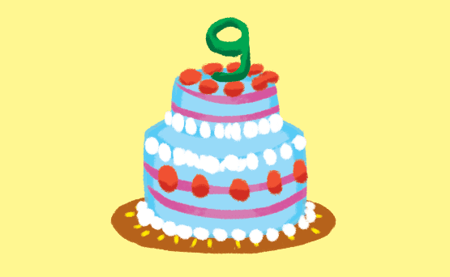
How old are you?
A
B
I’m nine
years old.
I’m fine.
Thank you.

Slide 4
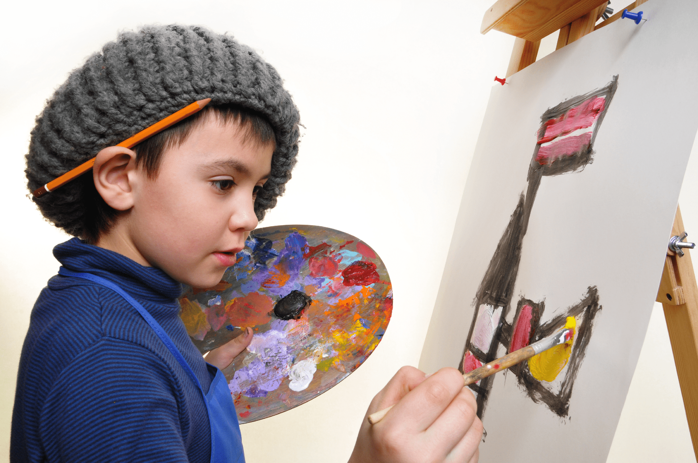
What’s your hobby?
A
B
It’s Ben.
It’s drawing.

Slide 5
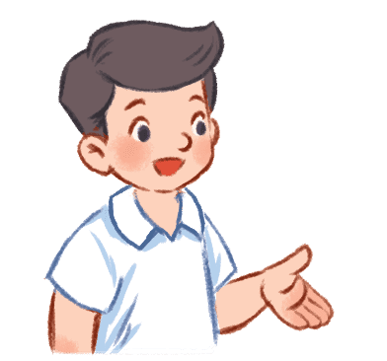
Is that Nam?
A
B
Yes, it is.
He is Mr Long.

Slide 6
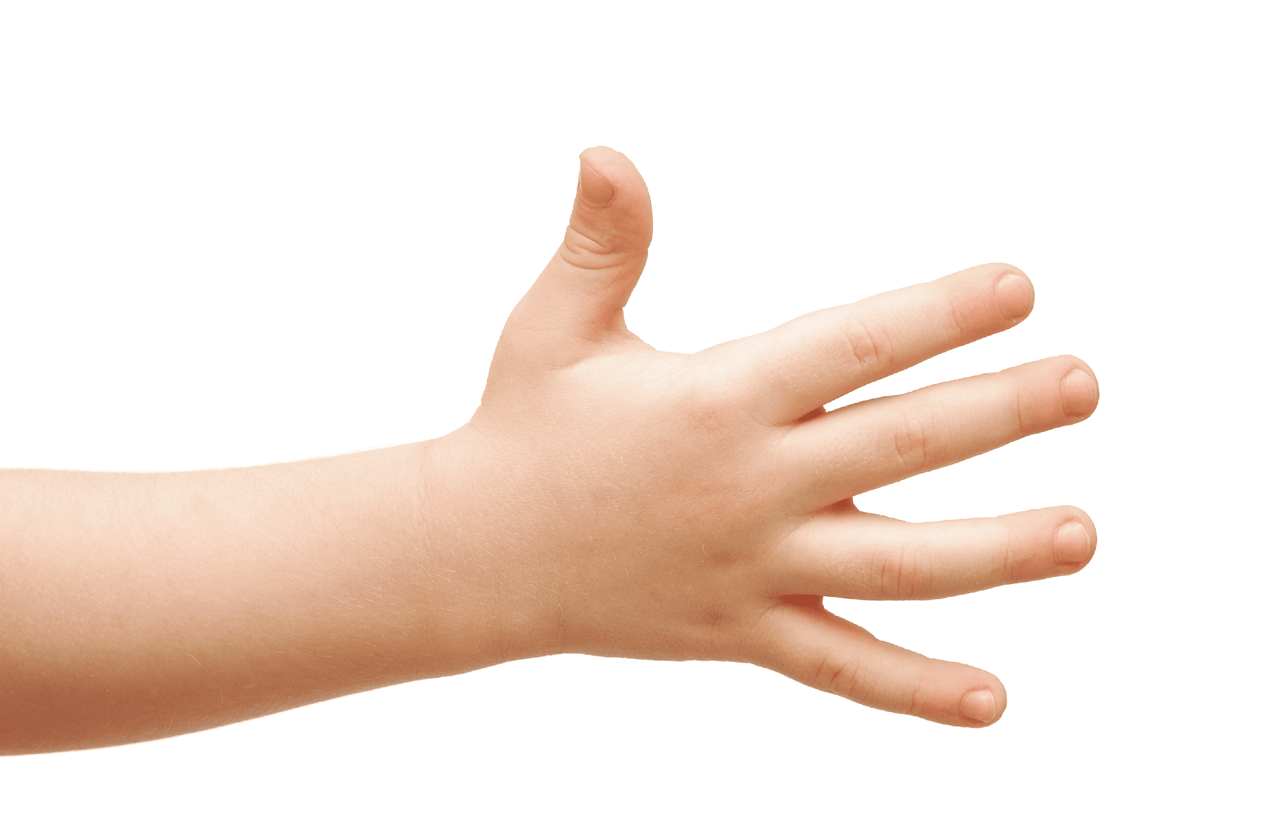
What’s this?
A
B
Touch your
hand.
It’s a hand.

Slide 7
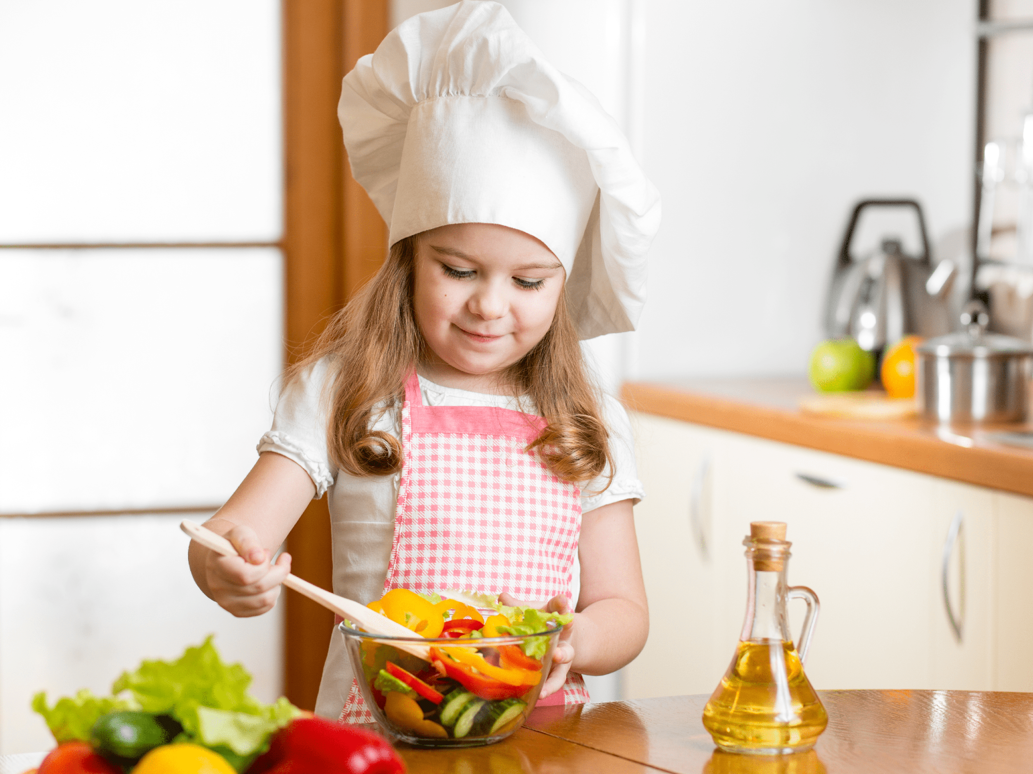
What’s your hobby?
A
B
No, it isn’t.
I like cooking.

