Slide 1
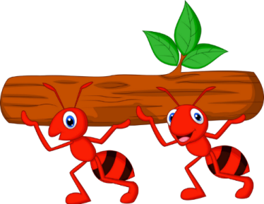
The studious ants
PLAY

Slide 2
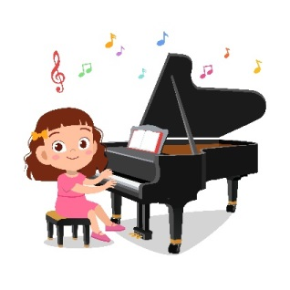
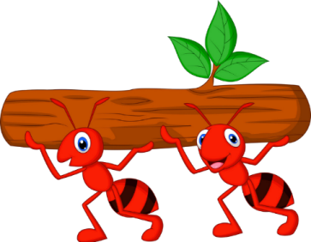
A: Can you ________?
B: Yes, I can.
play the piano
NEXT

Slide 3
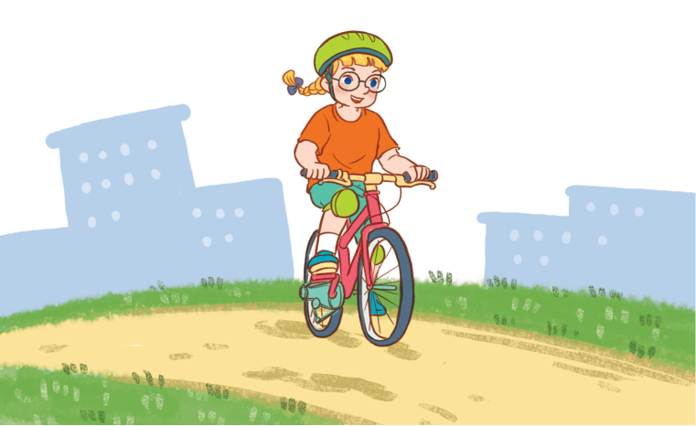
A: Can you ________?
B: Yes, I can.
ride a bike
NEXT

Slide 4
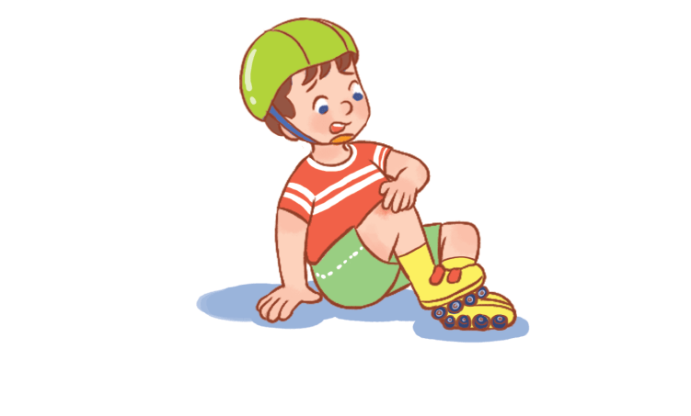
A: Can he ________?
B: No, he can’t, but he can cook.
roller skate
NEXT

Slide 5
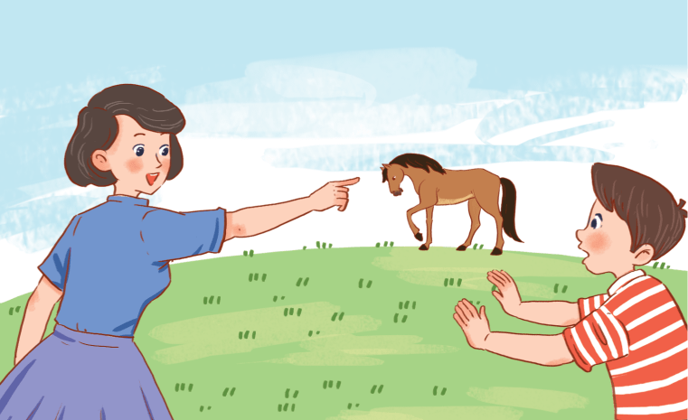
A: Can you ride a horse?
B: __________.
No, I can’t.
NEXT

Slide 6
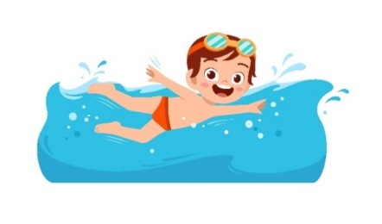
A: Can he swim?
B: __________.
Yes, he can.
NEXT

Slide 7
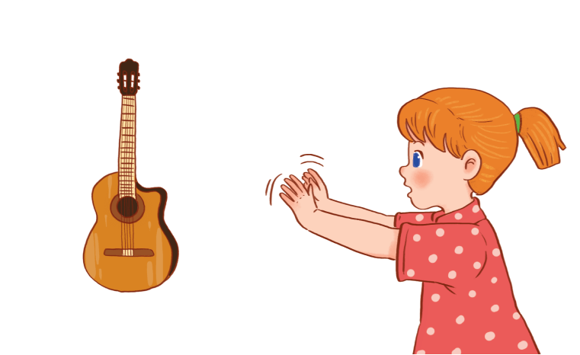
A: Can you _________?
B: __________.
play the guitar / No, I can’t.
NEXT

Slide 8
A: Can she roller skate?
B: Yes,__________.
She can
NEXT

Slide 9
A: ___ he _______?
B: Yes,________.
Can / roller skate / he can
NEXT

Slide 10
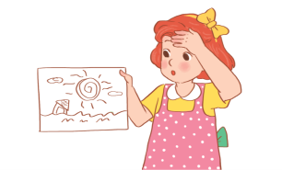
A: Can she draw?
B: ___, she can’t, ___ she can fly a kite.
No / but
NEXT

Slide 11
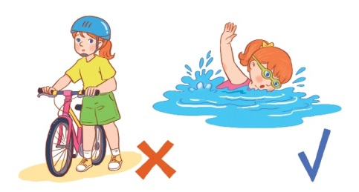
A: Can she ride a bike?
B: ___________.
No, she can’t, but she can swim.
NEXT

